Slide 1
X-section BN-BS
See Cross section locations.kmz & Cross section labels.kmz for location in Google Earth

Slide 2

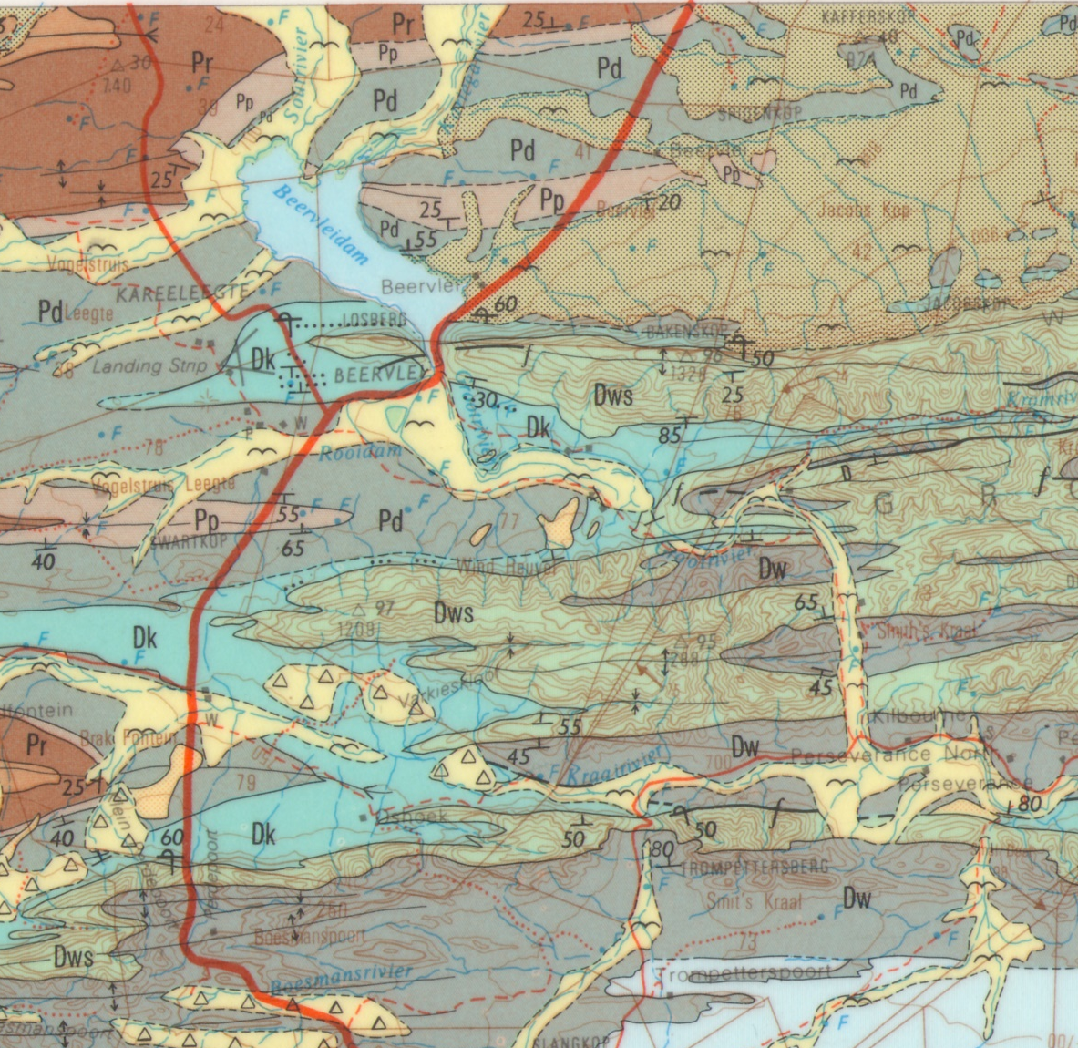
Schematic Geologic Cross Section BN-BS Beervlei Dam
BN
BN
BS
masl
masl
1500
f
1500
1000
1000
Pr
Dw
Da
Pp
Dk
Pd
500
Pr
Pd
Dk
Dk
Da
500
Pp
Dk
Dws
Pd
0
Dws
Dw
0
Dw
Da
Da
Da
-500
-500
Undifferentiated Cape Supergroup
-1000
-1000
0
7.5
15
22.5
Km
BS

